Slide 1
Hotel Mnagement Application

Slide 2
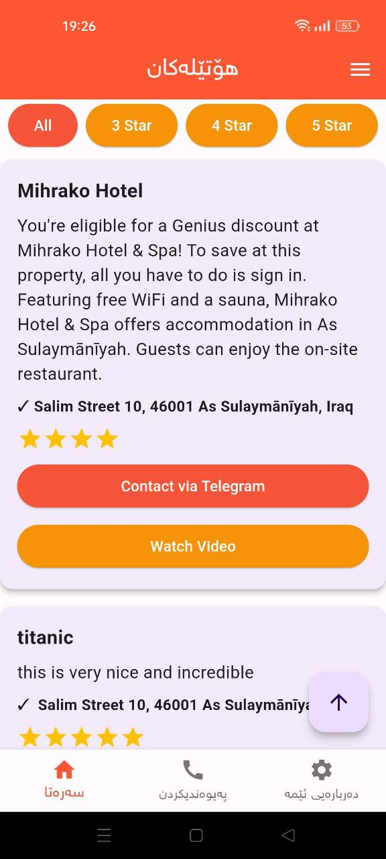
Home Screen

Slide 3
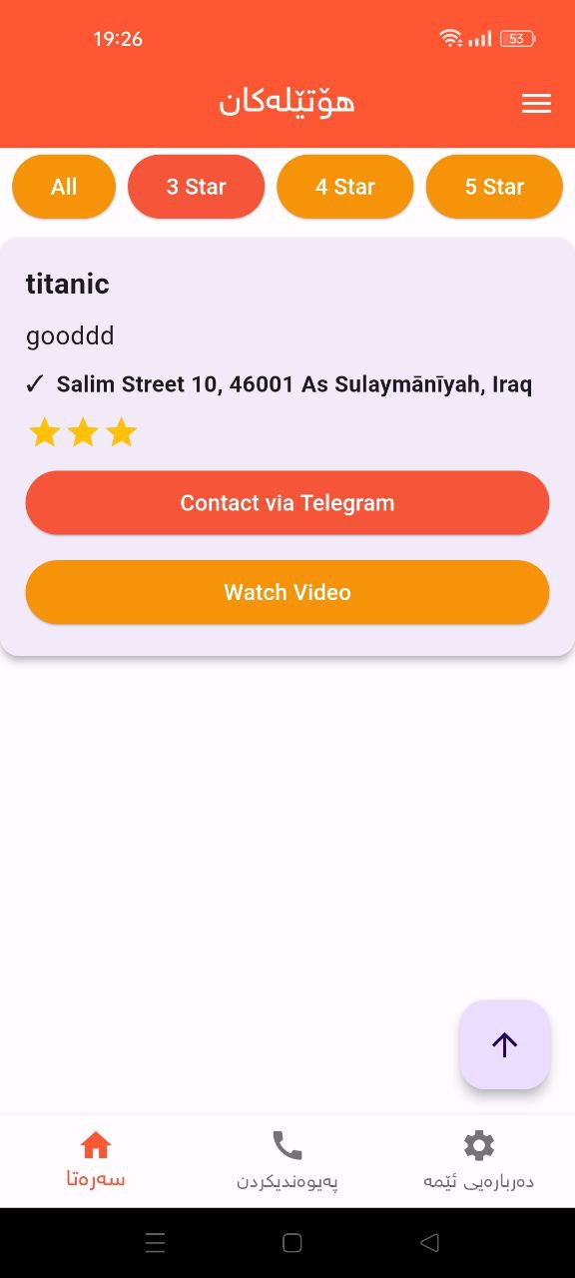
Home(3 stars)

Slide 4
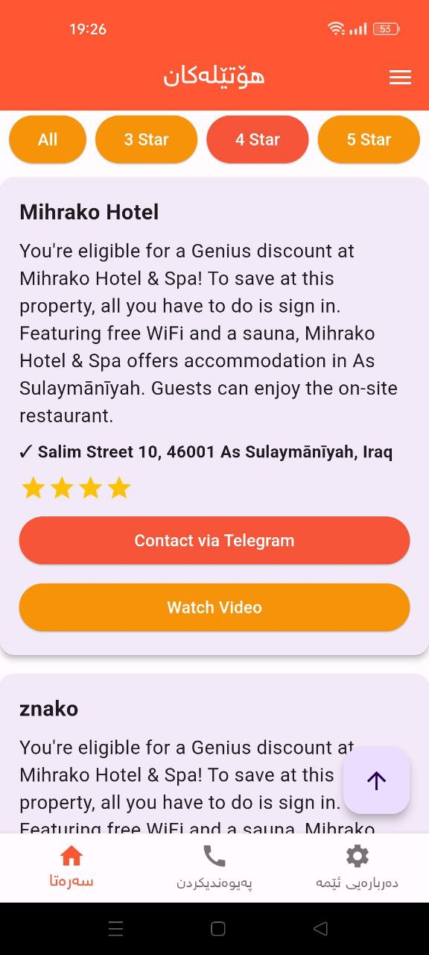
Home(4 stars)

Slide 5
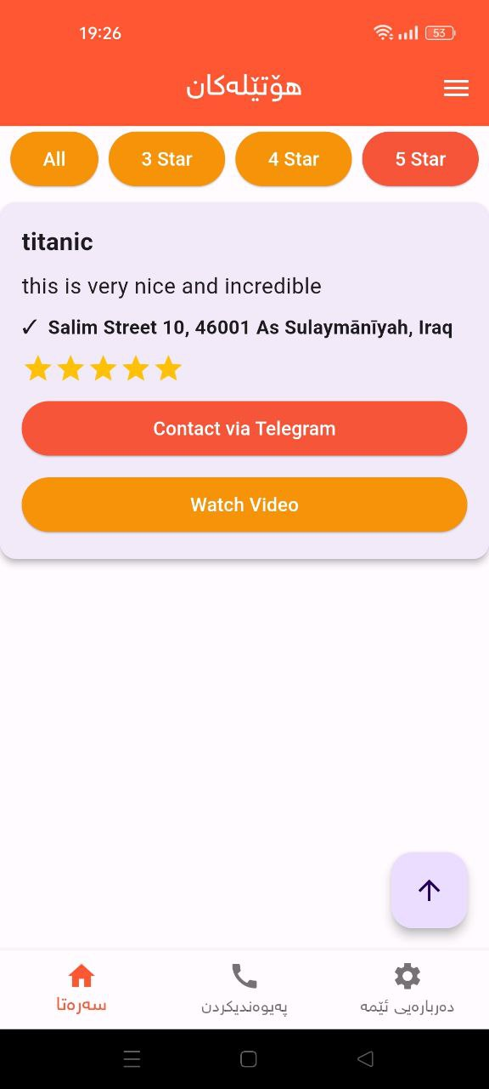
Home(5 stars)

Slide 6
Admin Part

Slide 7
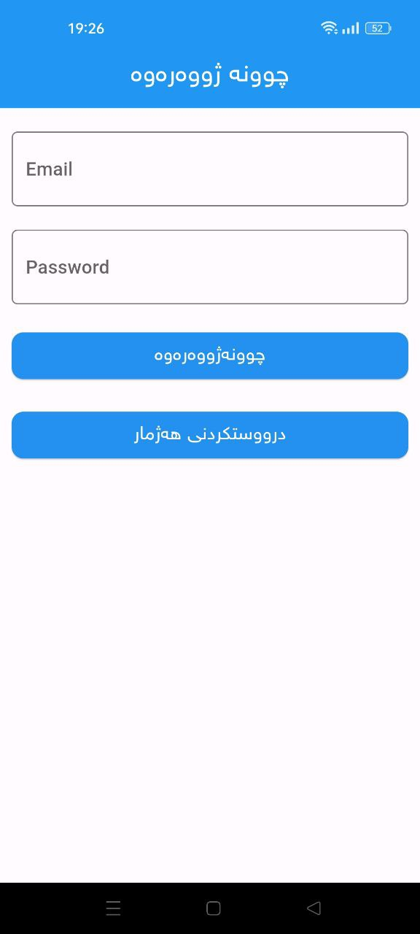
login

Slide 8
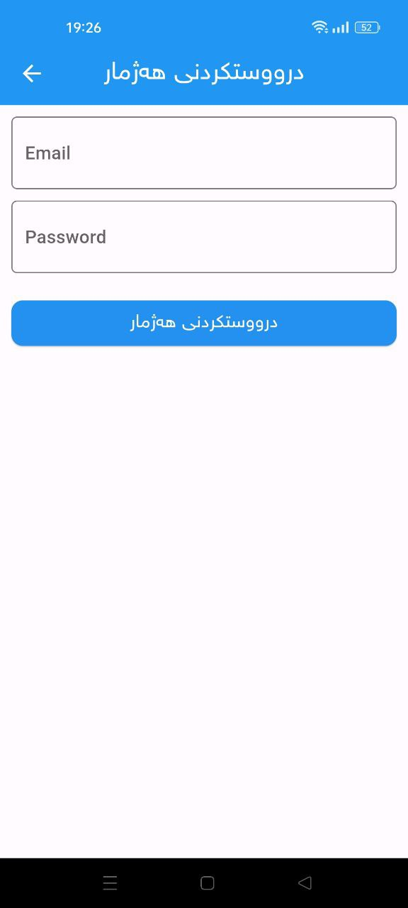
sign in

Slide 9
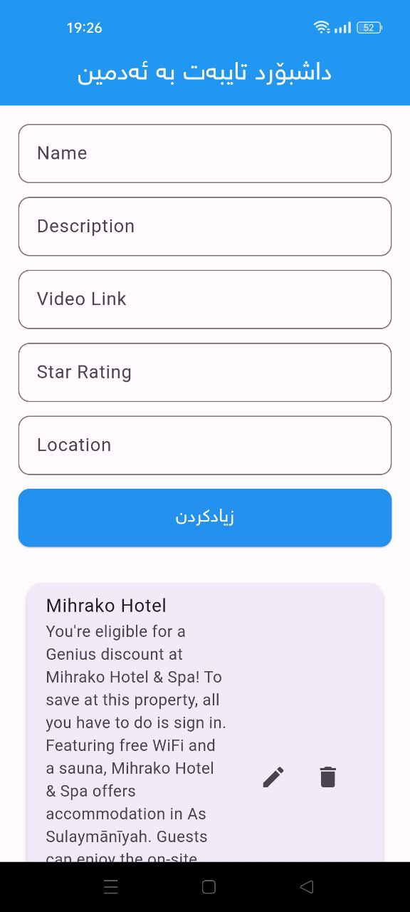
Dashboard

Slide 10
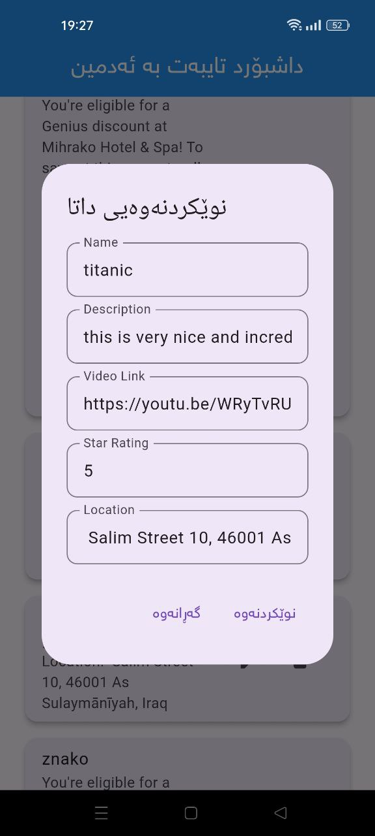
update data

Slide 11
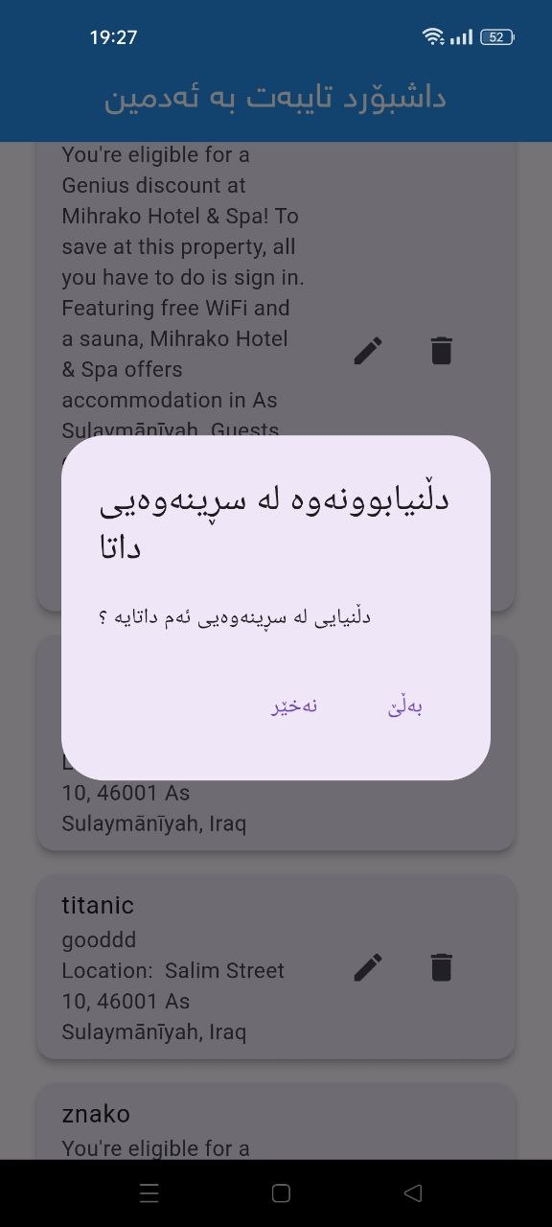
Delete data

